Slide 1
CS 4873: Computing, Society & Professionalism Blair MacIntyre | Professor | School of Interactive Computing
Week 2: Rhetoric & Writing Arguments
January 27, 2021
Slides adapted from Sauvik Das, Munmun de Choudhury, and Amy Bruckman

Slide 2
Term Paper (and Homeworks)
Term Paper
Most important single assignment in this class.
Worth 25% of your grade by itself (35% including related assignments).
For the term paper you’ll be:
Researching an issue about computing and society on which you are initially undecided
Taking a position based on your research
Writing an argument to support that position
Homeworks
Shorter writing assignments, 15% of your grade
Also writing arguments
Don’t really need the full structures discussed here
This is a quick primer on writing arguments!

Slide 3

What’s in an argument?
An argument states a claim and supports it with reasons and evidence from sources.
Persuasion: The process of convincing someone to do or believe something.
End-goal: convincing others
(not necessarily a bad thing)
Argumentation: The process of establishing a claim and then supporting it with the use of logical reasoning, examples and research.
End-goal: consensus on “truth”
Notes:
“truth seeking”

Slide 4
Issue questions and Information questions
Issue questions are the origin or arguments: Can usually be reasonably answered in multiple different ways.
Is CS4873 an interesting and useful class?
Information questions generally have one factual answer.
How many students are registered in CS4873 this semester?
To tell the difference:
What’s your purpose in relation with the audience?
Teacher? Probably information question
Advocate / decision maker? Probably issue question
Can a simple gathering of facts answer it?
Sometimes contextually dependent
e.g., is encryption effective?

Slide 5

Issue or Information Q:
What percentage of public schools in the United States are failing?
What is the effect on children of playing first-person-shooter games?
Is genetically modified corn safe for human consumption?
Should people get rid of their land lines and have only cell phones?
Notes:
What does it mean for a school to fail? Can define that in multiple ways.
What does “safe for human consumption” mean? Immediately kills you?

Slide 6
Pseudo-arguments
Rational arguments require two things:
Reasonable participants
Shared assumptions that can serve as a starting point
Lacking either of these, arguments devolve into “pseudo-arguments”

Slide 7
Unreasonable participants: Committed Believers and Fanatical Skeptics
Committed believers:
Have their convictions and will not accept any claims that are inconsistent
Russel’s teapot
Fanatical skeptic:
Demand definitive proof when no proof is possible (e.g., that the sun will rise tomorrow)
Accept nothing short of absolute proof, which is usually impossible
Both are “unreasonable” in the context of argumentation
Notes:
Two ends of the spectrum of unreasonable participants…
Russell’s teapot – philosophical burden of proof lies upon a person making unfalsifiable claims.
Teapot orbits the Sun in an elliptical orbit somewhere in space between Earth and Mars. Too small for even most powerful telescopes to detect.
Who says no?
Can’t disprove, doesn’t mean that it’s proved.

Slide 8
Lack of shared assumptions
Ideology
Literal interpretation of the bible vs metaphorical interpretation
Lack of shared assumption will lead to an impasse in discussing issues like evolution
Personal opinions
“Nachos are better than pizza because nachos taste better”
Notes:
The second way you can get into a pseudo argument is through the lack of shared assumptions.
You and your interlocutor need to agree upon a starting point if any consensus is to be reached.
Examples of the lack of shared assumptions?
- Idealogues
- Bringing in highly personal opinions

Slide 9
Which of the following will more likely lead to rational arguments? Why?
Are the Star Wars films good science fiction?
Is it ethically justifiable to capture dolphins and train them for human entertainment?

Slide 10
Rhetoric 101

Slide 11
The rhetorical triangle
Logos: appeal from logic
e.g., You could protect yourself from 97% of malware by keeping your computer up-to-date.
Ethos: appeal from character, authority, credibility
e.g., Trust me, I have a Ph.D. in cybersecurity.
Pathos: appeal from emotion, audience’s sympathy
e.g., Sue did not update her computer, and now has to pay someone 500,000 USD in Bitcoin to unlock the only photos she has remaining of her late grandson.
Notes:
What’s an example?

Slide 12
The Rhetorical…Rectangle?
Kairos: appeal from opportunity / timing. Saying the right thing at the right time.
e.g., Russian cybercrime units targeted U.S. citizens with malware to facilitate DDoS attacks on core U.S. infrastructure ahead of the 2020 election.
What are examples of an argument that has Kairos right now?
What are examples of an argument that does not have Kairos right now?
Notes:
Fall 2020: 2020 election; pandemics; racial justice
Fall 2018: Twitter banning Alex Jones; Colin Kaepernick Nike ad; Bob Woodward book on Preisdent Trump
Fall 2017: Should you dox a nazi?
Fall 2016: Racism and Colin Kapernick’s protest
Fall 2015: Immigration reform
Fall 2014: ALS
Non-kairotic:
Earthquake relief for Haiti

Slide 13
Rhetorical tools
Logos: appeals to logic
Ethos: appeals to authority
Pathos: appeals to emotion
Kairos: timeliness
Pick tools that are most convincing to your target audience
Notes:
Class q: what are the four rhetorical tools we discussed? Logos, ethos and kairos

Slide 14
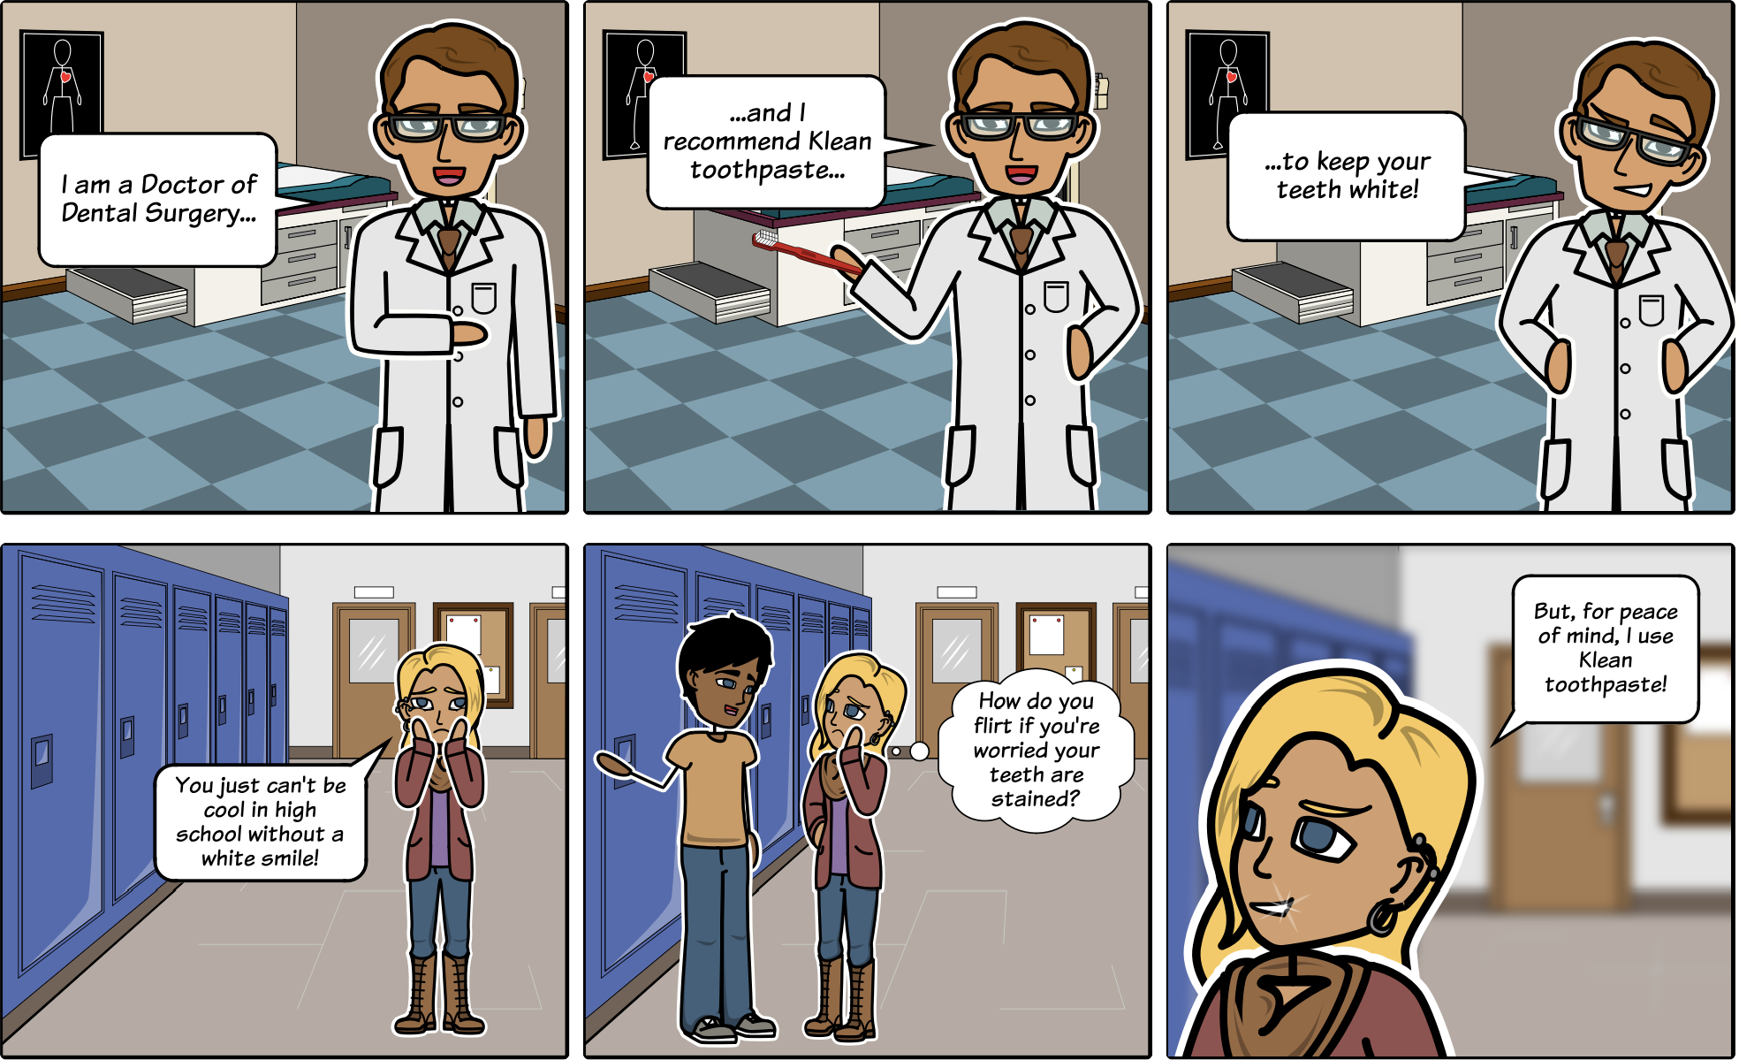
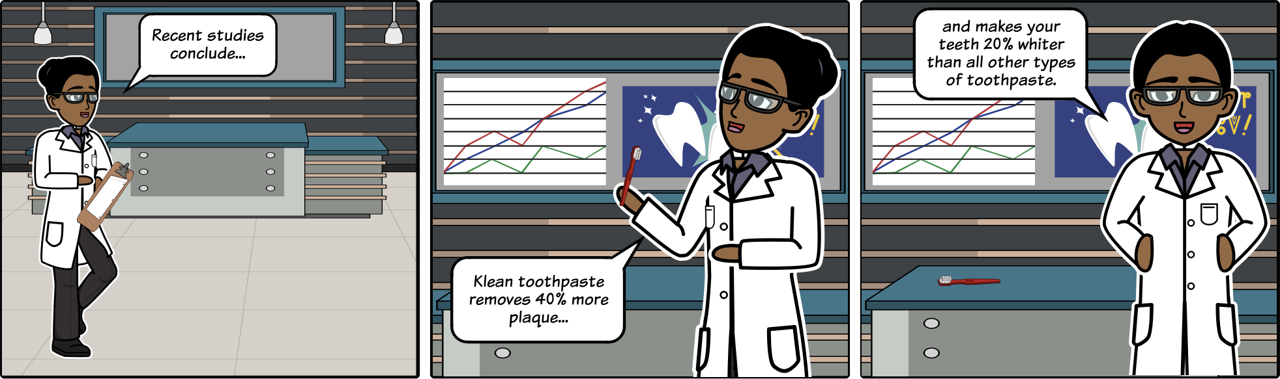
Ethos appeals to: Intelligence Virtue Morals Perception of trustworthiness
Pathos appeals to:
Emotions
Biases/prejudices Senses Motivations
Logos utilizes: Evidence Testimony Statistics and Data
Universal truths

Slide 15
Notes:
Microsoft tablet – year 2000. Wasn’t the right time.

Slide 16
Writing arguments

Slide 17
Writing Arguments
The argumentative essay is a genre of writing that requires you to:
Investigate a topic;
Collect, generate and evaluate evidence; and,
Establish a position on the topic in a concise manner.
You’re going to be writing an argumentative essay for your term paper!
Different types of argument structures.

Slide 18
Classical Arguments
Patterned after persuasive speeches of ancient Greek and Roman orators.
Structure:
Exordium / Narratio: Introduction & Background
Proposito: Presentation of writer’s position
Confirmatio: Summary of opposing views
Refutatio: Response to opposing views
Peroratio: Conclusion
Notes:
Many ways to make an argument -- one of the most common is what’s called the classical argument

Slide 19
Introduction
Purpose: connect to the audience, get their attention
Structure:
Attention grabber (e.g., a memorable scene, illustrative story, remarkable stat)
Explanation of issue and needed background (e.g., question)
Thesis (i.e., main claim)
Forecasting (i.e., outline rest of essay)
“Tell ‘em what you’re about to tell them”

Slide 20
Presentation of writer’s position
Purpose: Support thesis
Structure:
Main body of essay
Present and support each reason in turn
Tie to a value or belief held by the audience
“Tell ‘em”

Slide 21
Summary of opposing views
Purpose: Establish knowledge of alternative viewpoints
Structure:
Fair and complete summary of opposing viewpoints
Can either by one-by-one or all together

Slide 22
Response to opposing views
Purpose: Illustrate in what ways the proponent’s thesis is superior and inferior to the opposing views
Structure
Refute or concede to opposing views
Show weaknesses in opposing views
Possibly concede on some strengths

Slide 23
Conclusion
Purpose: Bring closure
Structure:
Sum up thesis
Leave strong last impression
Call to action
“Tell ‘em what you told ‘em”

Slide 24
Classical argument
Appeals to neutral or undecided audience
Summarize opposing views fairly
Principle of charity
Avoid distorting or oversimplifying opposing views
Don’t strawman
Once you summarize opposing views, either rebut or concede

Slide 25
Not the only way to do it
Classical arguments are effective but they may not always the most persuasive.

Slide 26
Delayed-thesis argument
Audience: Skeptical with limited knowledge of issue
Complicates the issue (instead of simplifying). Heightens reader interest and sympathy.
Intro
Dialogic discussion
Explores issue from multiple viewpoints
Delayed thesis and support
Conclusion

Slide 27
Adversarial vs Dialogic
In adversarial, writer presents other side as flawed
Typical argument you see in politics
Dialogic is more neutral – “truth seeking”
Enlists reader as a partner in truth seeking
Encourage sympathy for more than one point of view

Slide 28
Rogerian argument
Audience: Interested and resistant
Show that writer and resistant audience share many values
Wait until the end to express a view that is usually a compromise between the writer’s original view and the resistant audience
Especially effective in emotionally laden issues
Must understand audience POV
Stresses self-examination, clarification and accommodation rather than refutation

Slide 29
Rogerian argument structure
Intro
Summary of audience’s views
Common ground
Contribution of new points to the negotiation
Conclusion

Slide 30
Choose structure based on your audience
Who is your audience?
How much does your audience know or care about your issue?
What is your audience’s current attitude towards the issue?
What will be your audience’s likely objections?
What values, beliefs, or assumptions about the world do you and your audience share?

Slide 31
Toulmin method for constructing claims

Slide 32
Enthymeme
An enthymeme is a claim supported by reasons.
Claims answer an issue question
Reasons are claims used to support other claims
‘because’ clauses make the relationship clear
“After school jobs are bad for teenagers because they take away study time”

Slide 33
Enthymeme
Enthymeme’s are incomplete logical structures
Underlying assumptions must be stated to “complete” theme.
This assumption is called the warrant.
Claim | After-school jobs are bad for teenagers
Reason | Because they take away study time
Warrant | Loss of study time is bad

Slide 34
Enthymeme
Counter-claim: After school jobs are good for teenagers because they teach responsibility and time management.
Claim
Reason
Warrant

Slide 35
Enthymeme
Claim | After-school jobs are good for teenagers
Reason | Because they teach responsibility and time management
Warrant | Learning responsibility and time management is good
Counter-claim: After school jobs are good for teenagers because they teach responsibility and time management.

Slide 36
Grounds
Claim | After-school jobs are good for teenagers
Reason | Because they teach responsibility and time management
Warrant | Learning responsibility and time management is good
Grounds | Evidence that teenagers with after-school jobs are more responsible and have better time management
Grounds are supporting evidence that causes the audience to support your reason.

Slide 37
Backing
Claim | After-school jobs are good for teenagers
Reason | Because they teach responsibility and time management
Warrant | Learning responsibility and time management is good
Grounds | Evidence that teenagers with after-school jobs are more responsible and have better time management
Backing | Evidence that more responsible teenagers with better time management skills have better outcomes
Arguments that support the warrant

Slide 38
Conditions of rebuttal
To rebut an argument, one can undermine:
Reasons and grounds
Warrant and backing

Slide 39
Evidence

Slide 40
What is evidence?
All the verifiable information a writer might use as support for their argument.
Part of the “grounds” and “backing” of an argument in support of reasons and warrant.
Many different types of evidence… what are examples?

Slide 41
Persuasive Use of Evidence
Apply the STAR Criteria (by Richard Fulkerson)
Sufficiency: Is there enough evidence?
Typicality: Is the chosen evidence representative and typical?
Accuracy: Is the evidence accurate and up to date?
Relevance: Is the evidence relevant to the claim?

Slide 42
Sources
Use sources your audience can trust
Take into account, for example, the political leanings of the source
Level of review to have something published
Very different review process for different publications
Journalism
Book chapters
Refereed journal articles
Conference papers
Refereed
Non-refereed

Slide 43
Types of Evidence
Examples from personal experience or knowledge
Personal observation or field research
Interviews, questionnaires & surveys
Data from reading and extant research
Testimony
Statistical data
Hypothetical examples, cases and scenarios
Notes:
Hypothetical: Consider what would happen if we created a sentient AI that decided the best way to ensure its survival is to destroy humanity…
Reasoned sequence: Embyronic stem cells require us to classify embryos as cellular matter that can be manipulated at will. We do not that for animals. If we did it for humans, it could devalue human life.

Slide 44
Personal experience
“Despite the recent criticism that Ritalin is overprescribed for ADHD, it can often seem like a miracle drug. My little brother is a perfect example, before he was given the drug, he was a terror in school...”
Strengths?
Limitations?
Notes:
Appeals to pathos if vivid
Personal examples are anecdotal, could be made up, not generalizable

Slide 45
Observation / field research
“The intersection at Fifth and Montgomery is particularly dangerous because pedestrians almost never find a comfortable break in the heavy flow of cars. On April 29, I watched 57 pedestrians cross the street. Not once did cars stop in both directions before the pedestrian stepped off the sidewalk onto the street… (continue with observed data about danger)”
Strengths?
Limitations?
Notes:
Gives feeling of scientific credibility
Enhances ethos of writer
Skeptics can point to flaws in methodology. Flaws in this?
- Is April 29th representative? What time of day?

Slide 46
Interviews / questionnaires
“Another reason to ban laptops from classroom is the extent to which laptop users disturb other students. In a questionnaire that I distributed to 50 students in my residence hall, a surprising 60% said that they were annoyed by fellow student’ sending email, paying their bills or surfing the web, while pretending to take notes in class. Additionally, I interviewed 5 students who gave me specific examples of how these distractions interfere with learning…”
Strengths?
Limitations?
Notes:
Increases author’s credibility – did the research
Can often provide rich , engaging stories to increase pathos
Skeptics can raise doubts about research methodology. What are examples in this paragraph?
Appropriateness of sample (one residence hall)
Leading questions, etc.

Slide 47
Testimony
“Although the Swedish economist Bjorn Lomborg claims that acid rain is not a significant problem, many environmentalists disagree. According to David Bellamany, president of the Conservation Foundation, “Acid rain does kill forests and people around the world, and it is still going so in the most polluted places, such as Russia” (qtd. In BBC News)”
Strengths?
Limitations?
Notes:
Many people like to defer judgment to established experts
Appeals to ethos
Less persuasive than direct data

Slide 48
Statistics
“Americans are delaying marriage at a surprising rate. In 1970, 85% of Americans between the ages of 25-29 years were married. In 2010, however, only 45% were married (A. Source).”
Strengths?
Limitations?
Notes:
Powerful snapshots of aggregate data
People like numbers
Skeptics can question methods, interpretation of data
They can be calculated and displayed in misleading ways (maybe they were married but got divorced?)

Slide 49
Framing evidence
We enter arguments as complex people, bringing in our own ideologies, beliefs and values. These guiding beliefs help create a writer’s “angle of vision”
How evidence is presented in an argument illustrates a writer’s angle of vision.
Two speakers arguing about how the city should spend money. The first argues in support of routing more resources to the homeless, the second argues to increase tourism.
First: Starts with a story of a homeless man spending a night in the freezing cold without shelter
Second: Starts with a story of how tourists in a popular shopping district are harassed by pan handlers.

Slide 50
Many strategies for framing evidence
Controlling the space given to supporting versus contrary evidence
Emphasizing a detailed story vs. presenting lots of facts and statistics
Provide contextual and interpretive comments when presenting data
Putting contrary evidence in subordinate positions
“Although mosh pit accidents are rare, when they do occur…”
“Although there have been cases of bad mosh pit accidents, they are very rare”
Changing labels and names that guide the reader’s response to data
“mosh pit” vs festival seating
Using images to guide the reader’s response to data
Openly address your underlying values in your framing

